Slide 1
Parallelization of Successive Over-Relaxation Method
Jered Dominguez-Trujillo

Slide 2
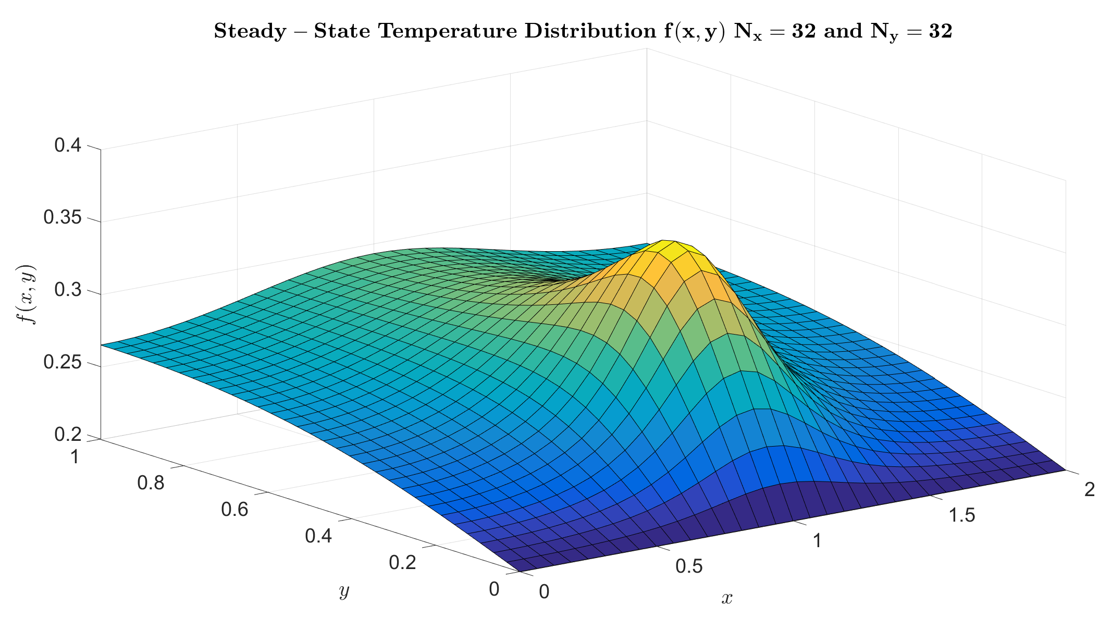
Introduction
Objective:
  Develop a Program that Implements a Parallel Successive Over-Relaxation (SOR) Method to Solve the Steady 2-Dimensional Heat Equation on a Rectangular Grid
Motivation:
  To Reduce Computation Times
  Enable Larger, More Refined Models to be Computed
Applications:
  Mechanical Engineering
    Computational Fluid Dynamic Simulations
    Heat Transfer (Conduction, Convection, Radiation) Problems
Successive Over-Relaxation is an Iterative Method of Solving Partial Differential Equations

Slide 3
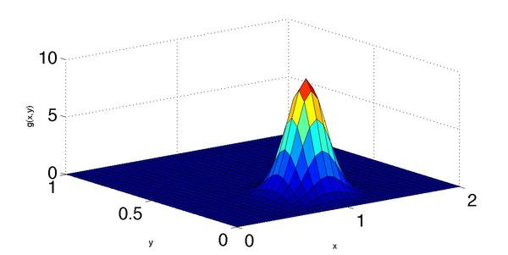
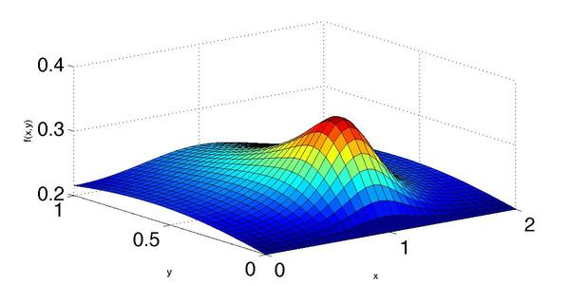
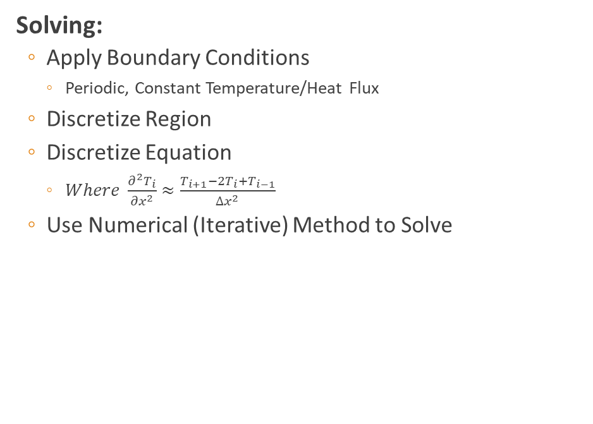

Methods: Heat Equation
Steady Problems:
  2nd Order Partial Differential Equation
  $k\left(\frac{∂^{2}T}{{∂x}^{2}}+\frac{∂^{2}T}{{∂y}^{2}}\right)+S\left(x,y\right)=0$
    $k=thermal conductivity$
    $T\left(x, y\right)=Temperature$
    $S(x, y)=Heat Source$
Solving:
  Apply Boundary Conditions
    Periodic, Constant Temperature/Heat Flux
  Discretize Region
  Discretize Equation
    $Where \frac{∂^{2}T_{i}}{{∂x}^{2}}≈\frac{T_{i+1}−2T_{i}+T_{i−1}}{Δx^{2}}$
  Use Numerical (Iterative) Method to Solve
Given Heat Source: S(x, y)
Solution (Steady-State): T(x, y)

Slide 4
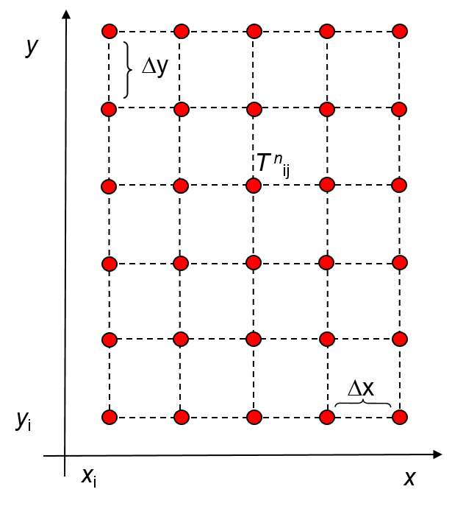
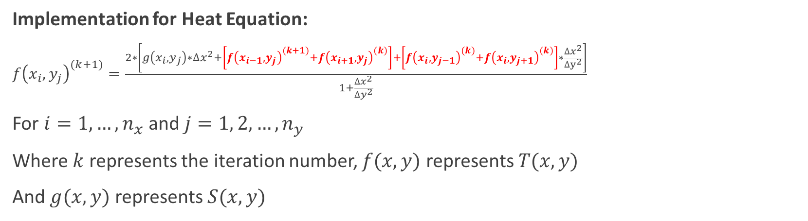
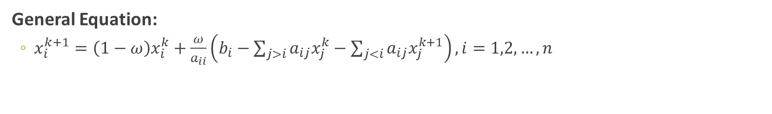
Methods: Successive Over-Relaxation
General Equation:
  $x_{i}^{k+1}=\left(1−ω\right)x_{i}^{k}+\frac{ω}{a_{ii}}\left(b_{i}−\sum_{j>i}^{ }{a_{ij}x_{j}^{k}}−\sum_{j<i}^{ }{a_{ij}x_{j}^{k+1}}\right), i=1,2,…,n$
Implementation for Heat Equation:
$f{\left(x_{i}, y_{j}\right)}^{(k+1)}=\frac{2∗\left[g\left(x_{i}, y_{j}\right)∗Δx^{2}+\left[f{\left(x_{i−1}, y_{j}\right)}^{(k+1)}+f{\left(x_{i+1}, y_{j}\right)}^{(k)}\right]+\left[f{\left(x_{i}, y_{j−1}\right)}^{(k)}+f{\left(x_{i}, y_{j+1}\right)}^{(k)}\right]∗\frac{Δx^{2}}{Δy^{2}}\right]}{1+\frac{Δx^{2}}{Δy^{2}}}$
For $i=1,…,n_{x}$ and $j=1, 2, …, n_{y}$
Where $k$ represents the iteration number, $f(x, y)$ represents $T(x, y)$
And $g(x, y)$ represents $S(x, y)$

Slide 5




















Approach
OpenMP, Multithreading on a Single Process
  Simple, Practical, and Effective
Challenges
  Data Dependency within the Grid
  i.e. Each Step through Each Iteration Requires Updated Grid Data
$$y_{4}$$
$$y_{4}$$
$$y_{3}$$
$$y_{3}$$
Legend
$$y_{2}$$
$$y_{2}$$
Current
Previously Updated
$$y_{1}$$
$$y_{1}$$
In Use for Calculation
Not Updated
$$y_{0}$$
$$y_{0}$$
$$x_{0}$$
$$x_{1}$$
$$x_{2}$$
$$x_{3}$$
$$x_{4}$$
$$x_{0}$$
$$x_{1}$$
$$x_{2}$$
$$x_{3}$$
$$x_{4}$$

Slide 6




















Implementation
Data-Dependence Solution:
  Red-Black Ordering Method
Red Nodes
Black Nodes
Red-Black Ordering Method:
  First, Update Red Nodes
  Then, Update Black Nodes
  Repeat Until Error is Smaller than Specified Tolerance
  Eliminates Data Dependence, Allowing Parallelism to be Implemented
$$y_{4}$$
$$y_{4}$$
$$y_{3}$$
$$y_{3}$$
$$y_{2}$$
$$y_{2}$$
$$y_{1}$$
$$y_{1}$$
$$y_{0}$$
$$y_{0}$$
$$x_{0}$$
$$x_{1}$$
$$x_{2}$$
$$x_{3}$$
$$x_{4}$$
$$x_{0}$$
$$x_{1}$$
$$x_{2}$$
$$x_{3}$$
$$x_{4}$$

Slide 7
Implementation
Each Iteration has 2 Parallel Regions:
  1. Parallel Region 1
  Spawn Threads
  Statically Assign Nodes
  Update Red Nodes
  2. Join and Sync Threads with a Thread Barrier
  3. Parallel Region 2
  Spawn Threads
  Statically Assign Nodes
  Update Black Nodes
  4. Join Threads
  5. Iterate Until Error is Below Specified Tolerance

Slide 8
Results: Speed-Up and Efficiency
Comments: Generally, Speed-Up Leveled Off at 16 Threads and Parallel Efficiency Decreased with Additional Threads

Slide 9
Results: Speed-Up and Efficiency
Comments: Anomaly at 1000 x 1000 System due to 1.5x Increase in Required Iterations

Slide 10
Conclusions
Computation Time Increases Quadratically Along with Grid Size
Long Computation Times for Large Systems
  Upwards of an hour
Parallelism Decreased Computation Times to 15 Minutes for a 2000 x 2000 System
Trade-Offs Between
  System Size
  Number of Threads
  Speed-Up
  Efficiency
Must Have Balance for Optimal Performance

